Slide 1

The New World of Enforcement and Importer Identity
Deringer Recommendations
Amy Magnus & Sandy Coty

Slide 2

Wake Up Calls
EO 14411, June 2, 2026 – Strengthening Customs Enforcement
  https://www.whitehouse.gov/presidential-actions/2026/06/strengthening-customs-enforcement/
Federal Register regarding 5106, August 19, 2026
  https://www.federalregister.gov/documents/2026/08/19/2026-16911/accuracy-of-importer-of-record-data-submitted-to-cbp6
Additional info regarding enforcement
  Strengthening Customs Enforcement | U.S. Customs and Border Protection
The New World of Enforcement | www.anderinger.com

Slide 3
We Highly Recommend Obtaining an ACE Portal Account
If you don’t have an ACE Portal Account, get one!
It allows you to:
  Review all entries that have been filed on your behalf to ensure compliant filings
    Manage Cape Refunds
    Manage CBP communication, such as CF28, 29, Detentions, CF 4647
    Verify 'known" brokers transmitting entries
    For information about using ACE Reports to monitor the total Section 232 duty amounts offset by import adjustment offset licenses for automobile and medium and heavy-duty parts, please refer to CSMS # 67640669.
  Sign up for refunds with a U.S. bank account so money passes between you and CBP, not a 3rd party
  Check your 5106 data and update when needed – VERY important now
  ACE Resource - https://www.cbp.gov/trade/automated/how-to-use-ace/portal-applying
The New World of Enforcement | www.anderinger.com

Slide 4
Deringer Recommends Signing up for an ACH Account Directly with CBP
Pay your duties directly to CBP via ACH
Receive refunds directly from CBP via ACH
Resource - https://www.cbp.gov/trade/automated/ach/signing
19 CFR 141.1(b) Payment of duties —
(1) Personal debt of importer. The liability for duties, both regular and additional, attaching on importation, constitutes a personal debt due from the importer to the United States which can be discharged only by payment in full of all duties legally accruing, unless relieved by law or regulation. Payment to a broker covering duties does not relieve the importer of liability if the duties are not paid by the broker. The liability may be enforced notwithstanding the fact that an erroneous construction of law or regulation may have enabled the importer to pass his goods through the customhouse without payment. Delivery of a Customs bond with an entry is solely to protect the revenue of the United States and does not relieve the importer of liabilities incurred from the importation of merchandise into the United States.
The New World of Enforcement | www.anderinger.com

Slide 5
New Requirements Regarding Importers Information
If CBP determines that the information provided on a CBP Form 5106 is inaccurate or incomplete, CBP will, as of September 18, 2026, immediately void the associated IOR number.
CBP will issue a written notice of this action to an IOR to the email address the IOR most recently submitted to CBP, that notifies the IOR of the basis for voiding the IOR number.
If applicable, CBP will copy the Customs broker that last filed entry on behalf of the IOR when issuing the notice.
The notice will include information on how to request reestablishment of the IOR number, including what information must be submitted to CBP to corroborate the identity of the requesting IOR. The IOR or a Customs broker with a valid POA may contact CBP at IORProgram@ cbp.dhs.gov with questions regarding a voided IOR number.
The New World of Enforcement | www.anderinger.com

Slide 6
More to Know About September 18th Requirement
When updating this and all other information on CBP Form 5106, the party certifying the CBP Form 5106 must take appropriate steps to verify the information prior to submission.
The certifying party may be subject to fines or imprisonment under 18 U.S.C. 1001 or other legal consequences for making an intentional false statement or committing deception or fraud on the CBP Form 5106.
Additionally, because IOR data is an important identifier for liability for payment of duties, the provision of inaccurate or misleading information on CBP Form 5106 is material to an obligation to pay money to CBP and could subject the IOR or associated individuals to liability under the False Claims Act or other laws.
Refer to CBP Form 5106 instructions for detailed requirements and ensure all updates and corrections are made promptly to avoid compliance issues and other consequences.
Customs brokers submitting inaccurate or invalid information on a CBP Form 5106 may also be subject to broker penalties or other consequences pursuant to 19 U.S.C. 1641.
The New World of Enforcement | www.anderinger.com

Slide 7
POAs… Minimum Steps Brokers May be Required to Verify
Did you dial the provided phone number for authentication? If so, what response was received?
Did you email and receive a confirmation from the email address provided? If so, what response was received?
Did you attempt to contact the importer at the mailing address provided? If so, what response was received?
Did you verify that the importer’s address is a “brick and mortar” location on a public mapping program? If the address is a “brick and mortar” location, do the employees physically work at the location or is the location a virtual mailing address such as a UPS Store mailbox?
Was the POA completed in person?
Was the grantor’s unexpired government issued photo identification reviewed? If so, please provide a copy of the grantor’s unexpired government issued photoidentification.
Did you check applicable websites to verify the POA grantor’s business and registration with the State authority?
If the principal uses a trade or fictitious name in doing business, did you confirm that the name appears on the POA?
The New World of Enforcement | www.anderinger.com

Slide 8
Additional Steps to Verify a POA
Did you verify that the importer’s name, importer’s number, and Employer Identification Number (EIN/Federal Tax Identification Number) on the POA match what is in ACE?
Did you cross-check the provided information through a third-party entity, i.e., credit report, DUNS number, or similar business identifying the entity?
Did you access the client’s website for depth of content versus only a surface containing a landing page?
Did you check whether the POA grantor is named as a sanctioned or restricted person or entity by the U.S. Government?
CBP may request the broker to provide any internal audits of your company’s steps in validating a POA and CBP Form 5106.
CBP may request the broker to provide written instructions and/or guidance in validating a POA and CBP Form 5106.
CBP may request the broker to describe all other steps taken to validate the POA, CBP Form 5106, and legitimacy of the IOR.
The New World of Enforcement | www.anderinger.com

Slide 9
CBPF 5106
Importer must ensure 5106 data is correct.
CBP will remove the importer’s EIN number and thus the importer’s ability to import if the 5106 is incomplete or incorrect.
If the importer does not have an ACE account, we recommend they fill out the paper 5106 and submit it to Deringer for a 5106 update.
Resource - https://www.cbp.gov/sites/default/files/2026-06/cbp_form_5106.pdf
The New World of Enforcement | www.anderinger.com

Slide 10
5106 Data Which Must Be Validated & Correct
Importer name,
Internal Revenue Service (IRS) Employer Identification Number (EIN), Social Security Number (SSN), or CBP-assigned number,
Mailing address (no PO Boxes),
Physical location address if different from the mailing address,
Phone number, and
Email address.
The above information MUST be the importer’s information, not the broker or forwarder’s information.
The New World of Enforcement | www.anderinger.com

Slide 11
The Freeze Program
Once 5106 data is verified or updated and corrected, we recommend the importer “freeze” their 5106 data.
The freeze program is the mechanism to freeze IOR 5106 information.
19 CFR 24.5 (f) “Freezing” importer identification information
Resource - Freeze Program | U.S. Customs and Border Protection
The New World of Enforcement | www.anderinger.com

Slide 12

The Freeze Program
What is the Freeze Program?
Designating the name and title/position of the individual(s) in their company authorized to effect name/address changes to the Importer’s Record Number (IRN). Doing so limits who can effect name/address changes to the IRN. Only the Surety Bonds & Accounts Team (SBAT) can process a name/address change on a “frozen” account. If a CBP Form 5106 is submitted to the SBAT a name/address change will only be made if the form is signed by one of the authorized individuals. Participation in the “Freeze” Program is voluntary.
How to participate in the Freeze Program?
The request must be made in a separate writing on letterhead paper signed by the importer of record or his agent, whose name and title are clearly indicated. The letter must also contain:
The mailing address and/or physical location address of the company where Customs notifications are to be directed
Reference the US Customs Regulation 19 CFR 24.5 (f) “Freezing” importer identification information.
The specific IRNs and suffixes to be frozen
The name and title/position of the individual(s) in their company authorized to effect name/address changes to the IRN
Freeze Letter Sample
How to discontinue in the Freeze Program?
The request must be made in a separate writing on letterhead paper signed by the importer of record or his agent, whose name and title are clearly indicated. The letter must also contain:
The mailing address and/or physical location address of the company where Customs notifications are to be directed
Reference the US Customs Regulation 19 CFR 24.5 (f) “Freezing” importer identification information, and request to be removed from the Freeze Program.
The specific IRNs and suffixes to be unfrozen
Unfreeze Letter Sample
Where do I submit the letter to participate or discontinue the Freeze Program?
Submit the requests via email to bondquestions@cbp.dhs.gov using the naming convention ‘Frozen IR #XX-XXXXXXXX’ or mail to:
U.S. Customs and Border Protection
Attn: Surety Bonds & Accounts Team
8899 E 56th St
Indianapolis, Indiana 46249
https://www.cbp.gov/trade/priority-issues/revenue/bonds/freeze-program
The New World of Enforcement | www.anderinger.com

Slide 13
Customs Trade Partnership Against Terrorism (CTPAT)
If the importer is not CTPAT, we recommend that a non-resident Canadian IOR consider applying for CTPAT.
CBP stated that CTPAT-validated brokers representing foreign IORs must meet a higher standard of due diligence.
  Vetting is expected to include information such as the importer’s legal identity, ownership structure, business affiliations, U.S. assets, compliance and import history, and ability to satisfy duties, taxes, and fees.
  Brokers may also be expected to examine supply-chain information, classification, valuation, and country of origin and maintain sufficient documentation to demonstrate the diligence performed.
Information about the CTPAT program
  Resource - https://www.cbp.gov/border-security/ports-entry/cargo-security/c-tpat-customs-trade-partnership-against-terrorism/apply
The New World of Enforcement | www.anderinger.com

Slide 14
Foreign IORs
May not rely on a continuous bond to meet the bond requirements for entry, except as permitted by CBP when the foreign IOR has demonstrated that the revenue would be fully protected and that compliance with the laws, regulations, and instructions enforced by CBP would be assured;
Must be validated in CBP’s Customs Trade Partnership Against Terrorism (CTPAT), if determined by CBP to be eligible, or use a CTPAT validated and licensed Customs broker to file entries with CBP.
The New World of Enforcement | www.anderinger.com

Slide 15
Resident vs. Non-Resident IOR
Among other things, a Non-Resident IOR must have tangible domestic assets, bonding, or both, as determined by U.S. Customs and Border Protection (CBP) to be necessary to ensure compliance with U.S. Customs and trade laws, and increasing the minimum required bond coverage for an IOR.
A Resident IOR must have a principal place of business in the U.S.
The Corporate Transparency Act of 2021 defines a beneficial owner “with respect to an entity who directly or indirectly exercises substantial control over the entity, or owns or controls not less than 25% of the ownership interest”.
The New World of Enforcement | www.anderinger.com

Slide 16
Good Standing
IORs not in “good standing” with CBP shall not be allowed to import into the United States or otherwise conduct activities directly related to the importation of goods, including designating a Customs broker to act as IOR on their behalf.
CBP shall define “good standing” based on the IOR’s and its affiliates’ history of compliance with U.S. Customs and trade laws and regulations and payment of required Customs liabilities, among other relevant considerations.
  For example, IORs that have been found by CBP to have illegally imported fentanyl, nitazene, or other illicit substances or contraband, including precursor chemicals for the purposes of manufacturing illicit substances, shall, consistent with applicable law, not be in “good standing” with CBP.
Good Standing will be based on compliance history, enforcement actions, and audit results, among other things.
The New World of Enforcement | www.anderinger.com

Slide 17
Your Action Plan Before September 18, 2026
Open an ACE Portal account!
Verify the 5106 data is correct:
  Importer name
  Internal Revenue Service (IRS) Employer Identification Number (EIN), Social Security Number (SSN), or CBP-assigned number
  Physical Address: The physical address provided for the IOR must be the actual physical location of the business or individual.[6] It cannot be a registered agent, Customs broker, freight forwarder, P.O. box, a business service center, or an address of another person or entity.
  Email Address: The email address submitted must be valid and belong to the IOR. Customs brokers or third parties may not supply their own email address, or the email address of another person or entity, in place of the IOR's email address.
  Phone Number: The phone number provided must be valid and belong to the IOR. Numbers not associated with the IOR should not be submitted. Customs brokers or third parties may not supply their own phone number, or the phone number of another person or entity, in place of the IOR's phone number.
If the importer does not have an ACE Portal, provide Deringer a paper 5106 so we can update the data
Consider the Freeze Program to lock IOR information
Enroll in ACH Debit or Credit directly with CBP for duty payments
Sign up for ACH refunds in the ACE portal
Questions on a voided IOR: IORProgram@cbp.dhs.gov . Deringer can help you respond.
  Resource - https://www.cbp.gov/trade/priority-issues/revenue/bonds/voided-importer-record-faqs
The New World of Enforcement | www.anderinger.com

Slide 18
ACE Portal Tips
The New World of Enforcement | www.anderinger.com

Slide 19

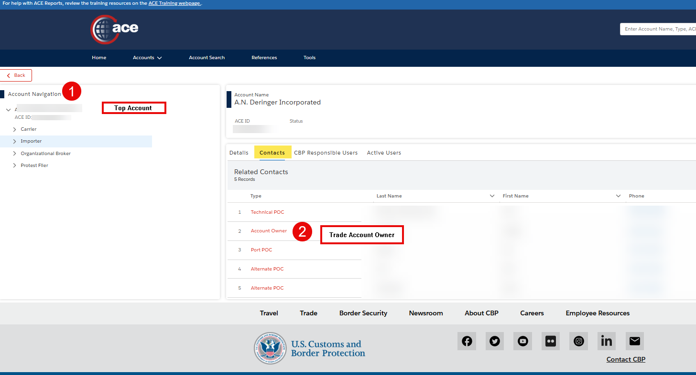
Who is my Trade Account Owner (TAO)?
Under Account Navigation Tree
Top Account
Contact
Account Owner
Additional Contacts such as Technical POC (Cyber)
Provide access to Top Account as Read only to Proxy and other users is a good practice
.
The New World of Enforcement | www.anderinger.com

Slide 20
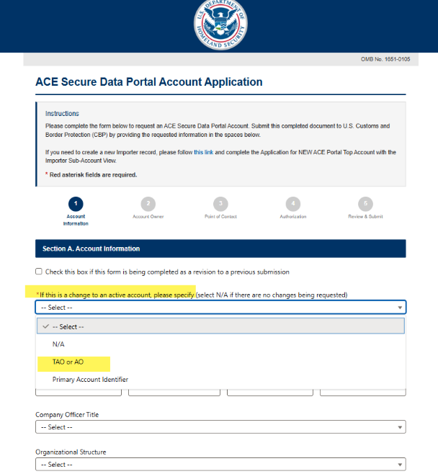
Updating Trade Account Owner
If you need help identifying the Trade Account Owner (TAO), email ace.support@cbp.dhs.gov with the subject line “Trade Account Lookup” and provide your full legal name and your EIN, SSN, or Customs-assigned number. CBP will email the TAO.
To update the Trade Account Owner: CBP modernized the ACE Secure Data Portal (ACE Portal) account application for the trade community. See CSMS # 68228015 - New ACE Portal Account Application Now Available.
There is a new process to update the Trade Account Owner for an existing active ACE Portal Account. The link below is for CBP’s new Web Form for the ACE Secure Data Portal Application; it replaces the legacy PDF form. This web-based form allows for faster processing by CBP. Link: https://aceaccountreview.cbp.gov/
Managing an ACE Secure Data Portal Account

Slide 21
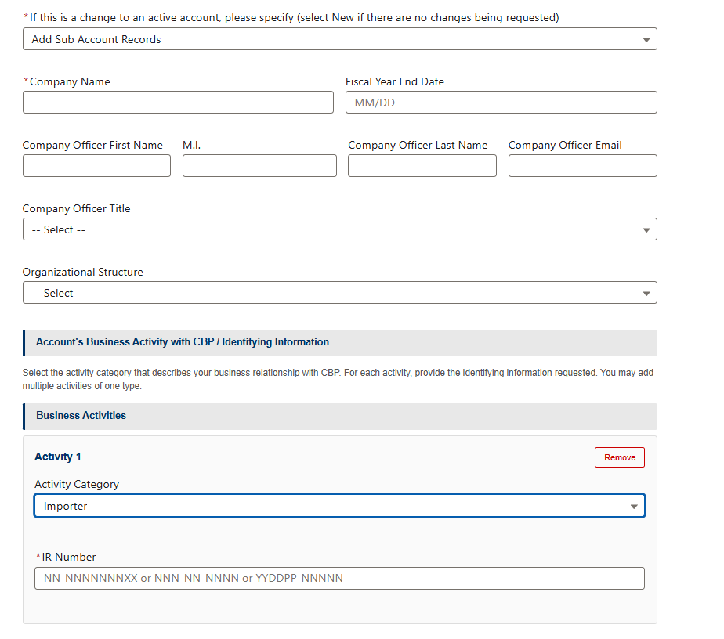
Applying for an ACE Secure Data Portal Account
If you are looking to add an Importer Sub-Account view to an existing Broker/Importer Top account, there is a new electronic form submission process.
Applying for an ACE Secure Data Portal Account webpage
Application for All Other Trade Activities
Use this updated application to:
Add one or more sub-accounts to an existing top account.
Add one or more sub-account identifiers to an existing sub-account view.
The New World of Enforcement | www.anderinger.com

Slide 22
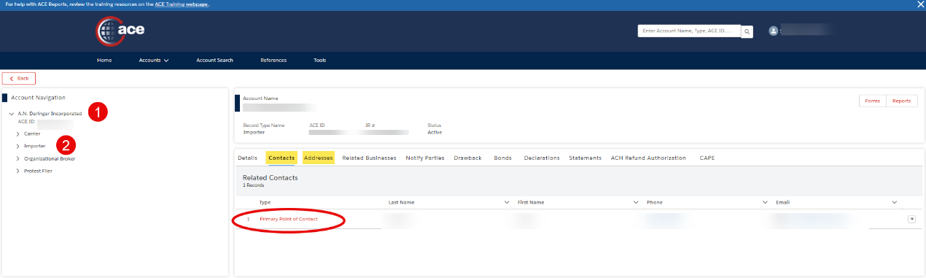
Importer Sub Account “Rolodex”
In the Importer Sub-Account (For each IOR/Suffix)
Primary POC
The New World of Enforcement | www.anderinger.com

Slide 23
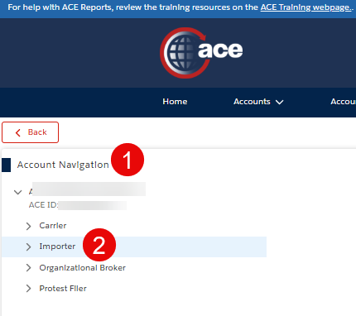
Importer Sub Account
CBP is placing emphasis on the address and current email and phone number on file for a 5106
The 5106 email and phone number updates the fields in Physical address found in the Addresses Tab at the Importer Sub Account.
5106 add/update in ABI updates the following data fields in ACE:
    Importer Sub Account for each Suffix
    Under Street (Physical) addresses tab
    Contact information under the Physical Address window
    If mailing address is sent, it will be found in the mailing address details in the addresses tab.
Note: The Contact Phone, Email, Website, Fax Number shown in the Additional Information section of the Details Tab on the Importer subaccount can be updated and maintained via the portal by way of the Physical Address (Contact Details section).
The New World of Enforcement | www.anderinger.com

Slide 24
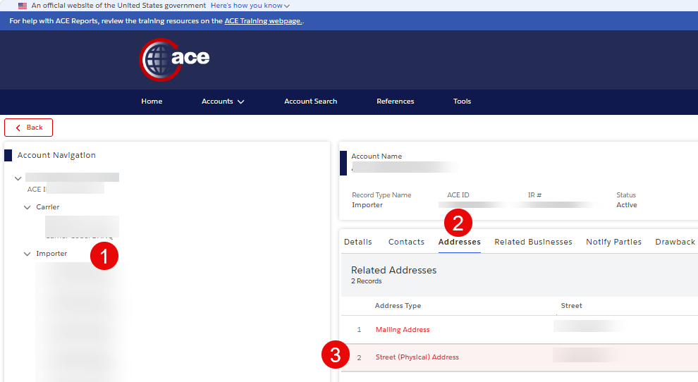
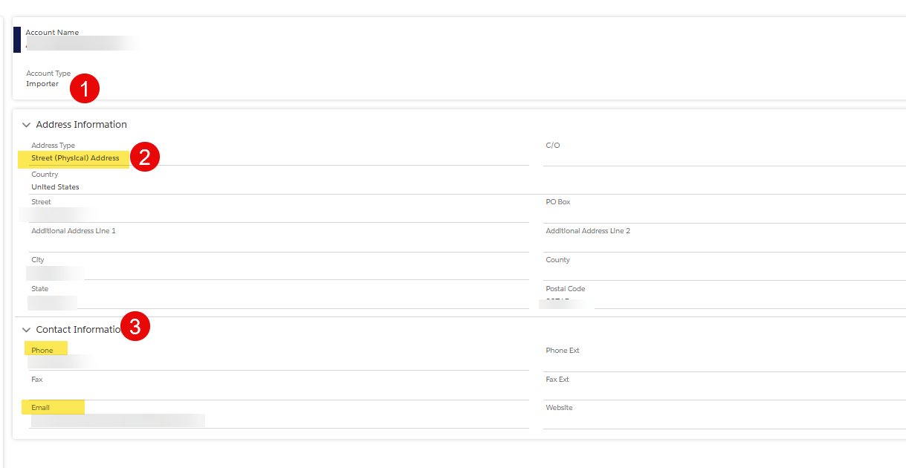
How to Verify the 5106 Importer Information in ACE Portal
Only Importer can see this information in their ACE Portal or broker if provisioned with cross account access
Can not be queried in the Importer Bond Query – only company name and address returned
The New World of Enforcement | www.anderinger.com

Slide 25
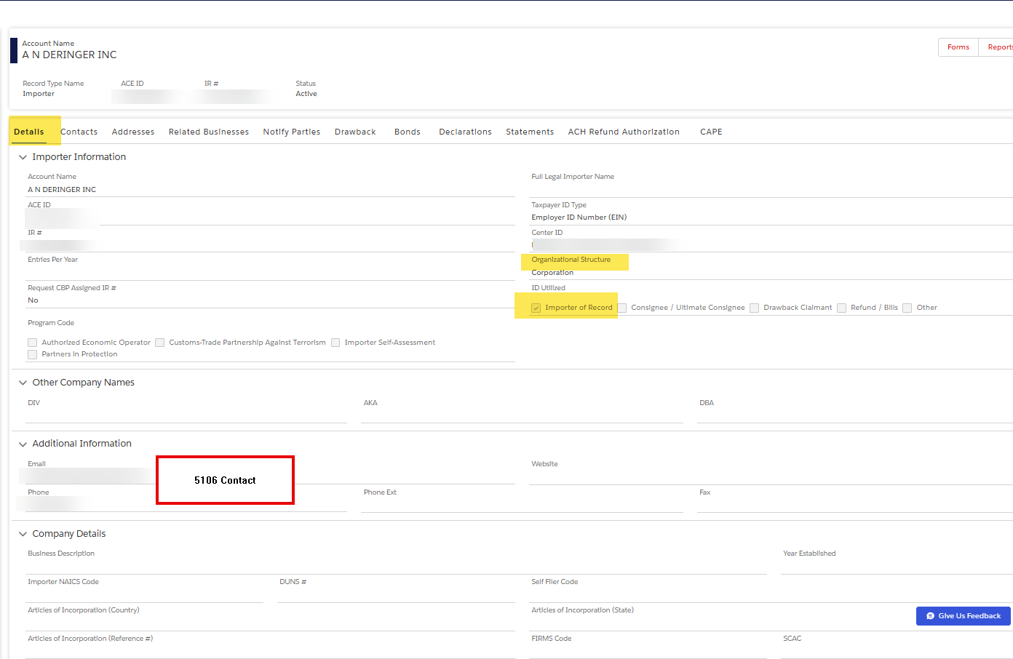
How to Verify the 5106 Importer Information in ACE Portal (cont.)
Additional Details from 5106
The New World of Enforcement | www.anderinger.com

Slide 26
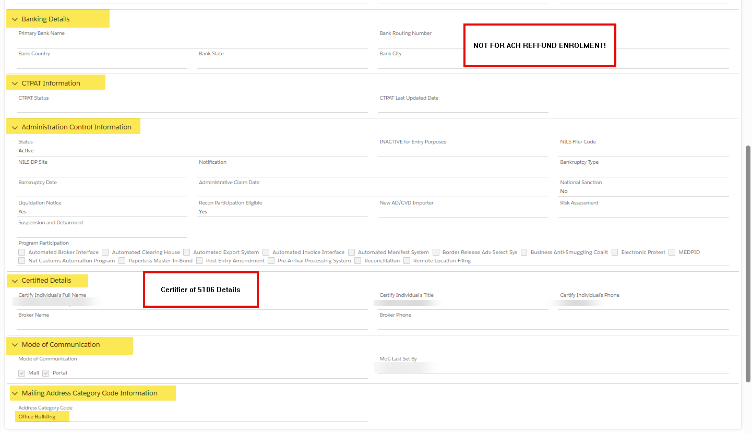
How to Verify the 5106 Importer Information in ACE Portal (cont.)
Additional Details from 5106
The New World of Enforcement | www.anderinger.com

Slide 27
Additional ACE Portal Tips
The New World of Enforcement | www.anderinger.com

Slide 28
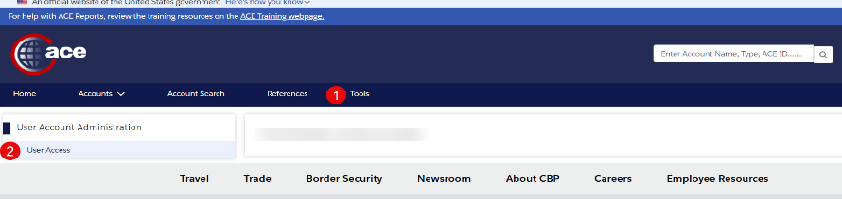
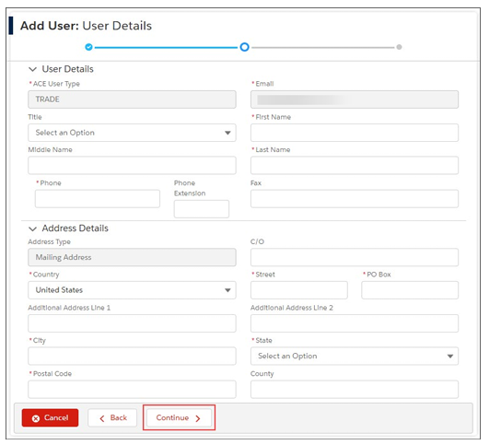
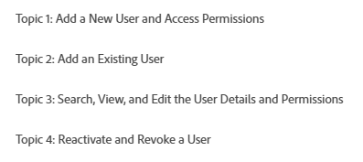
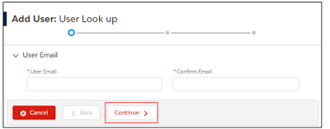
Add Existing or New User
ACE Portal: User Management
The New World of Enforcement | www.anderinger.com

Slide 29
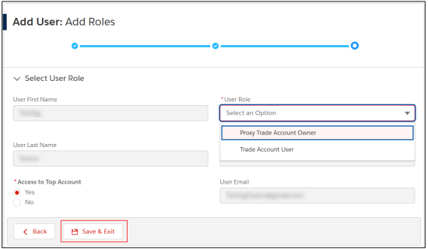
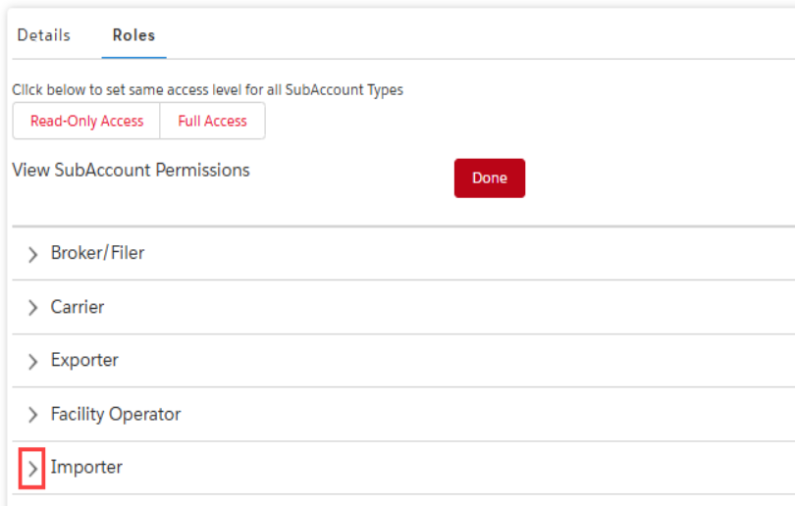
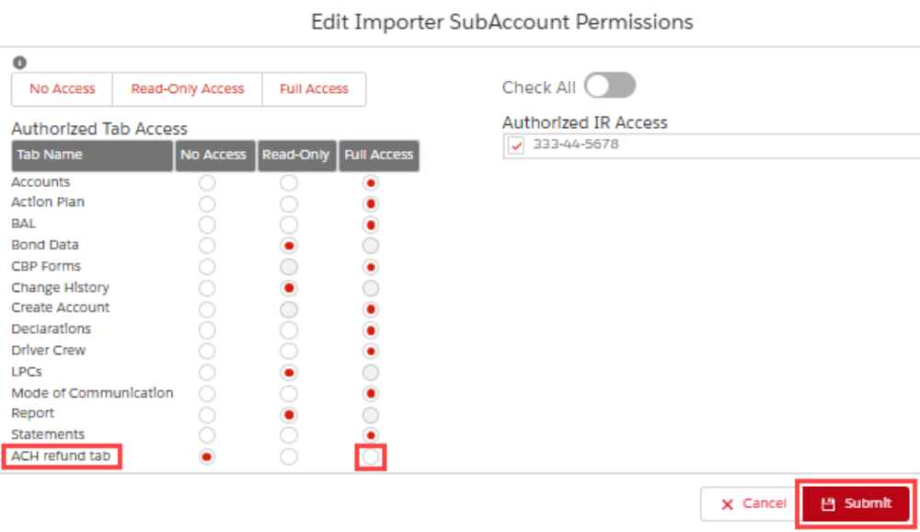
Provision User Role
The New World of Enforcement | www.anderinger.com

Slide 30
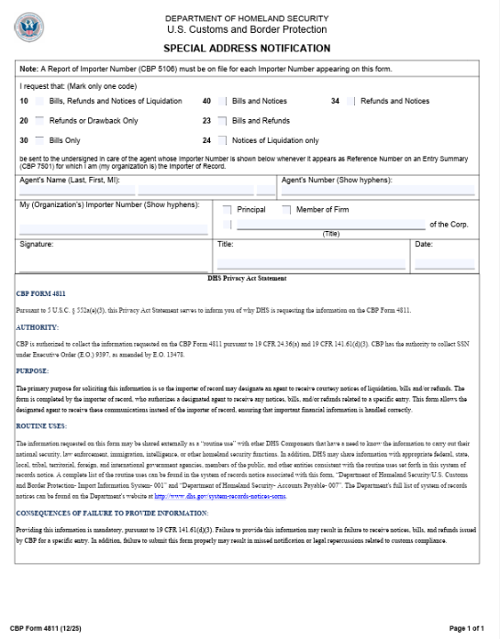
Designating an Agent for Refunds
CBP Form 4811
To add or modify a 4811 notify party:
Email the completed CBP Form 4811 to the Importer’s assigned Center of Excellence and Expertise (CEE).
Use the new “Add Notify Party” feature in the Notify Parties tab, available in the Importer sub-account view of the Trade user’s ACE Portal account.
Each Entry Summary must include the 4811 notify party’s number (Importer#) in box 28 “Reference Number” of the Entry Summary message set. If the Entry Summary does not contain a 4811 notify party, the refund will not be sent to the notify party.
An Entry Summary may be updated with the 4811 notify party by filing a PSC with the 4811 party in box 28 “Reference Number” of the Entry Summary and using the Header Reason Code “H99-Data Change-Other.” When filing a Protest, block 11 in section IV may be used to direct a refund to a designated agent.
(CSMS# 62234804, September 13, 2024; CSMS # 67648307, February 06, 2026)
The New World of Enforcement | www.anderinger.com

Slide 31
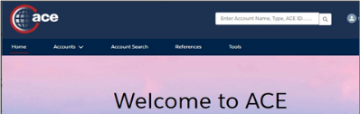
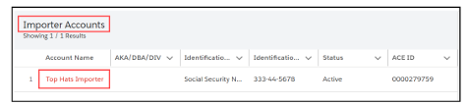
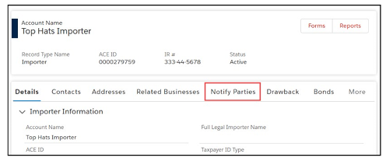
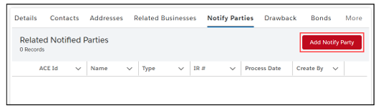
Designating an Agent for Refunds
ACE Portal – Notify Party
Use the new “Add Notify Party” feature in the Notify Parties tab, available in the Importer sub-account view of the Trade user’s ACE Portal account.
To revoke a notify party, trade users must contact their assigned Center. If an importer does not have a Center assignment, they must contact the Center that most closely aligns with the tariff number of the importer’s highest valued commodity.
When an importer has multiple notify parties on file in their ACE profile, refunds are directed to a notify party if two conditions are met:
  the notify party is on file in the importer’s ACE profile, and
  the notify party’s importer of record (IR) number is listed in box 28 “Reference Number” of the CBP Form 7501 or its electronic equivalent
(Quick Reference Card: Notify Party Information, December 2025; CSMS # 67648307, February 06, 2026)
The New World of Enforcement | www.anderinger.com

Slide 32
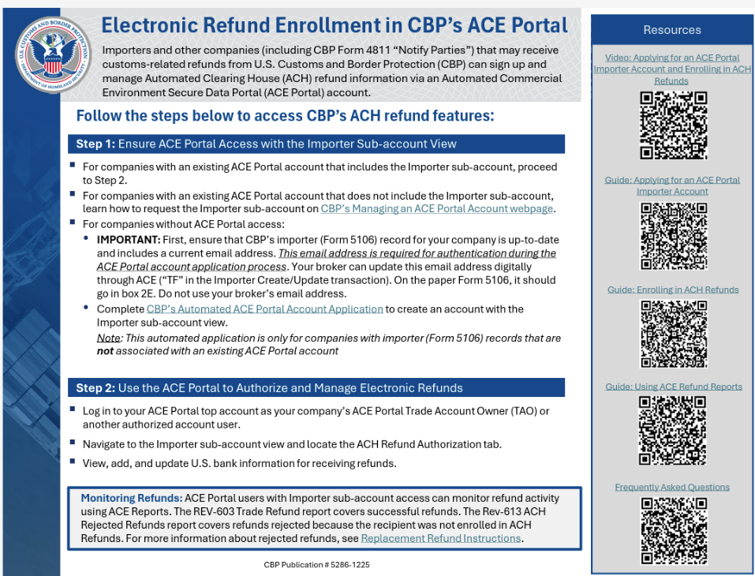
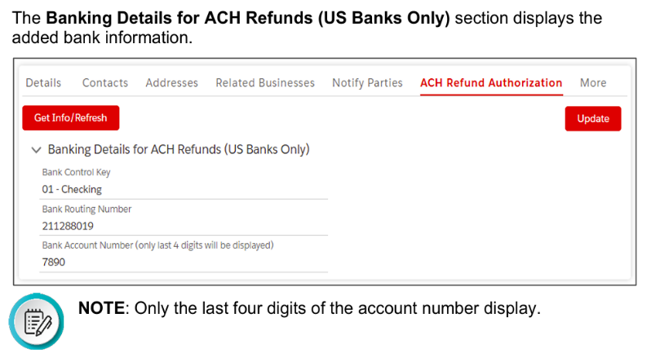
ACH Refund Setup
The New World of Enforcement | www.anderinger.com

Slide 33
ACE CAPE Reports & Managing Refunds
ACE CAPE Reports
The REV-613 ACH Rejected Refunds report highlights any refunds that have been rejected due to the recipient not being enrolled in ACH Refunds.
For help running this report, review the ACE Reports Trade Refund Report Quick Reference Card (QRC).
For more information about rejected refunds, review CBP’s Replacement Refund Instructions.
  ES 022 – CAPE Entry Summary Report
  REV-603 Trade Refund Report
  REV-615 CAPE Details Refund Report
  REV-613 ACH Rejected Refund
The New World of Enforcement | www.anderinger.com

